Slide 1






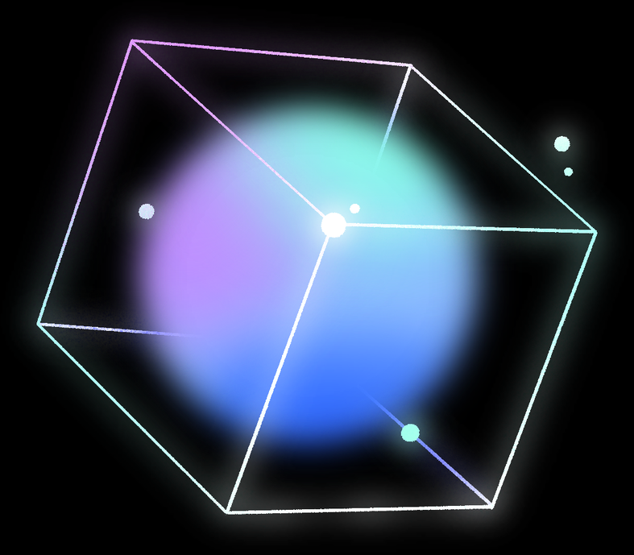

Xpert
Bridging the Expertise Gap in Pneumonia Diagosis through Explainable AI
Dubai Medical University Collaboration - IEEE SRC 2026 Published Paper

Slide 2


The Problem: The Diagnostic-Pedagogical Mismatch
83.3%
3.0/5.0
2.3/5.0
Of users fail to understand traditional X-ray explanations.[1]
Clinicians report moderate confidence in manual early-stage pneumonia detection.[1]
Opaque “Black Box” AI algorithm fail to build user trust.[1]
Pneumonia remains the leading infectious cause of death for children worldwide, claiming over 700,000 lives annually.[2]
Dubai Medical University Collaboration - IEEE SRC 2026 Published Paper

Slide 3


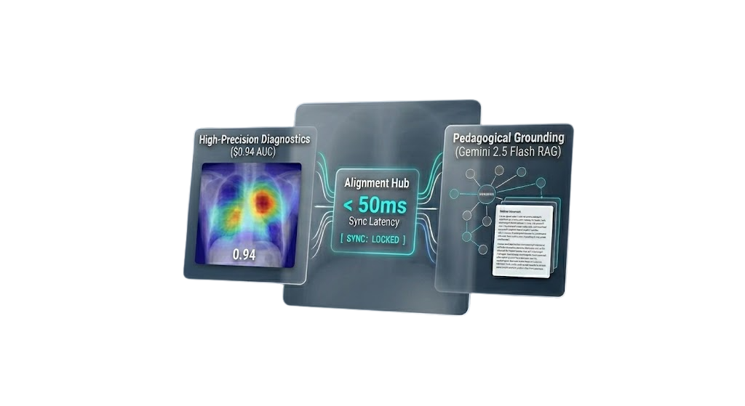

The Xpert Solution
Bridging the Gap through Dual-Engine Intelligence
Xpert is a medical diagnostic and pedagogical platform designed to harmonize high-precision AI with human-centered education.
We solve the trust crisis by moving beyond "Black Box" predictions and providing evidence-based insights.
The Diagnostic Engine (Clinical Vision)
The Pedagogical Engine (Adaptive Learning)
Isolation: 98.7% Lung Field Segmentation (via Custom Residual-CBAM U-Net).
Grounding: Medically grounded feedback using Gemini 2.5 Flash + RAG.
Detection: 0.94 AUC-ROC Accuracy (Clinical-Grade DenseNet-121).
Grounding: Medically grounded feedback using Gemini 2.5 Flash + RAG.

Slide 4

Dual-Engine Pipeline
FROM RAW PIXELS TO CLINICAL GROUNDING
Phase 01: Vision
Phase 02: INTELLIGENCE
Phase 03: PEDAGOGY
Diagonstic Vision
Deep Analytics
Adaptive Feedback
Quality Gate: Spatial normalization & denoising.
Classification: DenseNet-121 Pathogen Detection.
RAG Engine: Gemini 2.5 Flash Grounding.
Isolation: Residual-CBAM-ASPP Segmentation.
Explainability: Grad-CAM Visual Evidence.
UI Layer: < 3.0s End-to-End Latency.
98.7%
0.94
+75%
Segmentation Accuracy (DSC)
Diagnostic AUC-ROC Score
Increase in User Trust

Slide 5

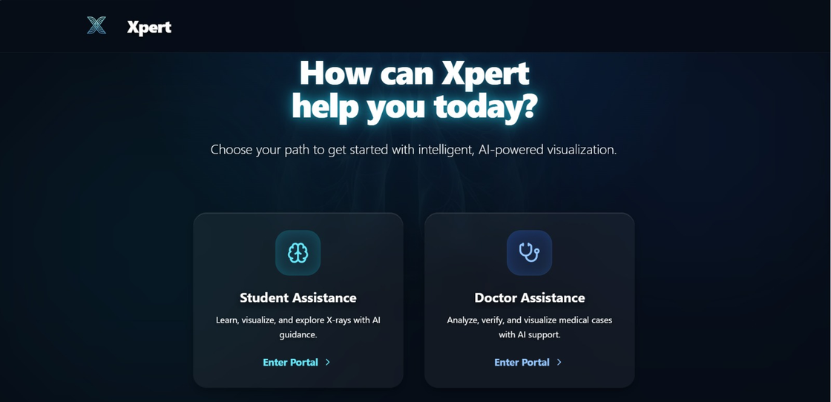
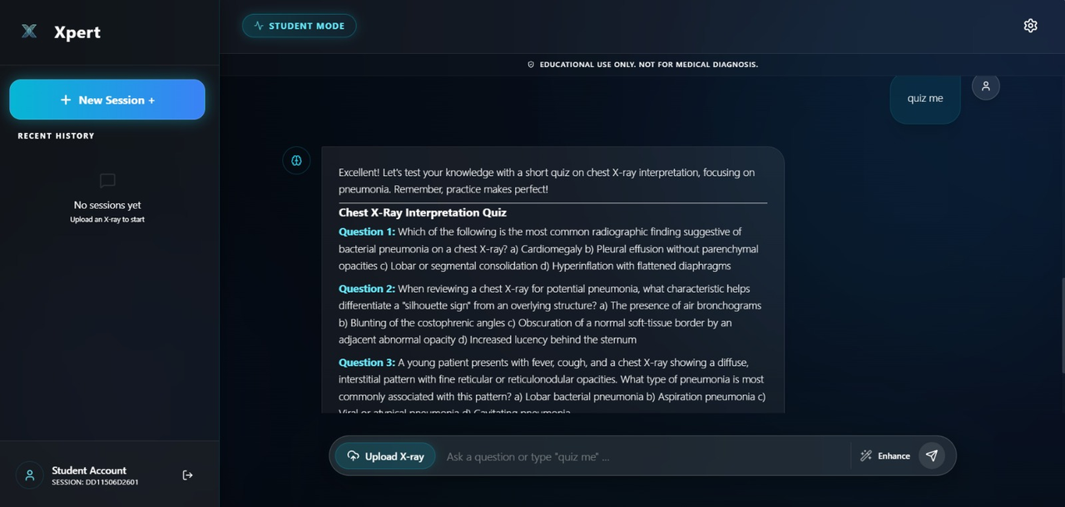
A Teacher On The Go
Xpert is a mentor, not just a calculator.
Xpert uses Gemini 2.5 Flash to plain why it found pneumonia. It references medical literature so students learn while they work.

Slide 6



Competitor Analysis Table
Feature / Domain
Xpert (Proposed System)
Clinical AI Tools (e.g., Aidoc, Lunit)
Traditional E-Learning (e.g., Radiopaedia)
System Objective
Dual-Purpose (Diagnostic Support + Pedagogy)
Clinical Efficiency (Triage)
Reference & Case Repository
Visualization Modality
Volumetric 3D & AR Overlay
2D Slice Viewing (DICOM)
Static 2D Images
AI Explainability (XAI)
Interactive Saliency Maps (Heatmaps)
"Black Box" Output (Binary Flags)
N/A (Human Annotation only)
Learning Methodology
Active Loop (Real-time AI Feedback)
None (Read-Only)
Passive (Reading/Observing)
Data Integrity
Real-World Anonymized Case Data
Clinical PACS Integration
Curated Static Library

Slide 7
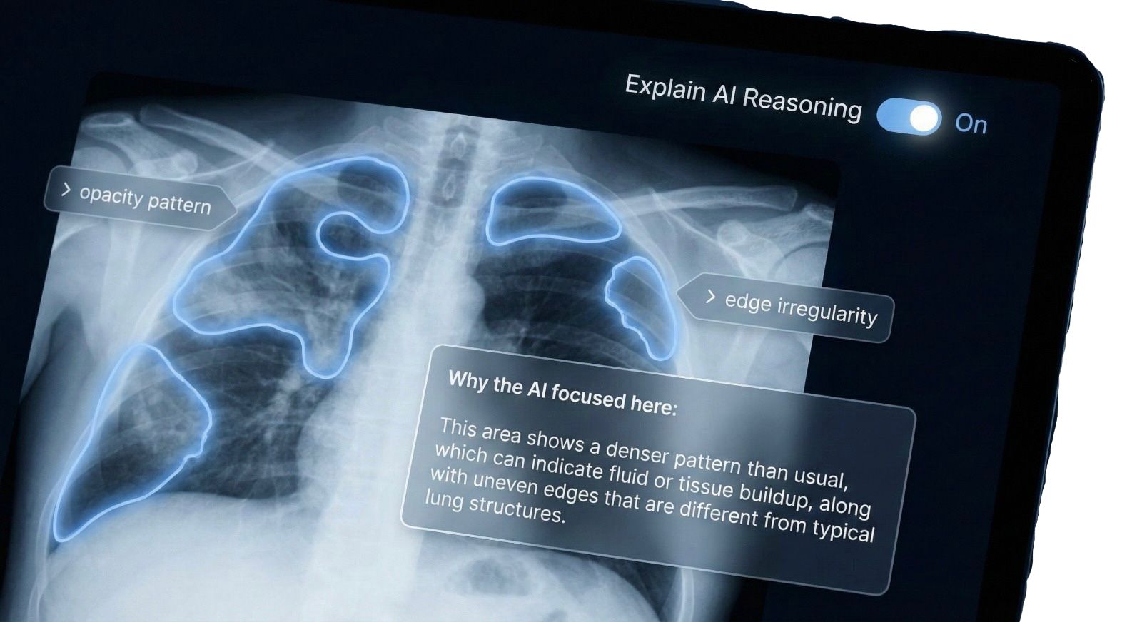
BUILDING ON A FOUNDATION OF TRUST
Ensuring Patient Privacy and Model Integrity through Future Added Cybersecurity Best Practices.
Security Standards: Future implementation will align with OWASP Top 10 for LLMs to prevent prompt injections and ensure model predictability.
Our framework is designed to utilize anonymized datasets, ensuring that no Personally Identifiable Information (PII) is processed by the AI engine

Slide 8

Milestones & Global Recognition
IEEE SRC 2026 Selection: Our core diagnostic methodology was peer-reviewed and accepted for presentation at the IEEE Student Research Conference.
Dubai AI Week Feature: Selected as a spotlight prototype for Dubai Medical University (DMU), showcasing the future of AI-augmented medical training.
Stakeholder Validation: Successfully tested and calibrated with 36 medical professionals to ensure clinical relevance.
Viral Engagement: Generated 30,000+ organic impressions within the medical and tech community, proving high demand for transparent AI.

Slide 9
References
Xpert Internal Research (2026). User Experience and Technical Needs for AI-Driven Medical Imaging: A Stakeholder Survey. University of Wollongong in Dubai.
World Health Organization (2026). World Health Statistics 2026: Monitoring Health for the SDGs.
Institute for Health Metrics and Evaluation (IHME) (2025). Global Burden of Disease Study 2023. (Updated February 2026).
Rajpurkar, P., et al. (2017). CheXNet: Radiologist-Level Pneumonia Detection on Chest X-Rays with Deep Learning. arXiv:1711.05225.
Geis, J. R., et al. (2019). Ethics of Artificial Intelligence in Radiology: Summary of the Joint European and North American Multisociety Statement. Radiology.
Wang, X., et al. (2017). ChestX-ray8: Hospital-scale Chest X-ray Database and Benchmarks on Weakly-Supervised Classification. IEEE CVPR.

Slide 10


THANK YOU!

